Slide 1
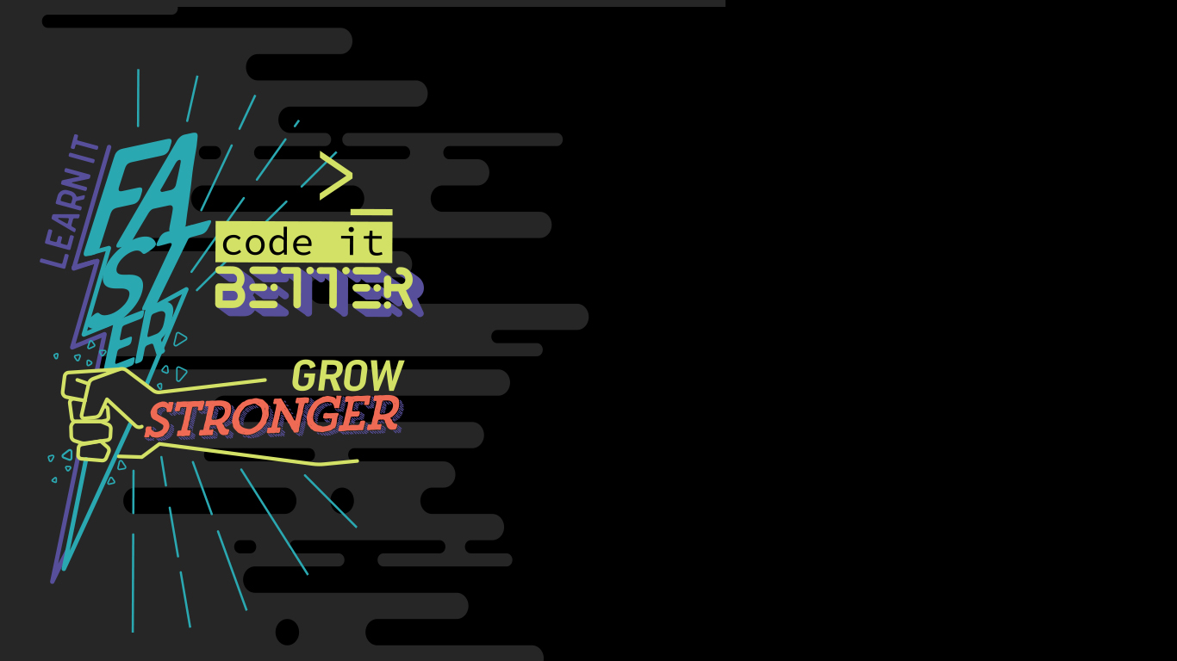


Shifting Security Left 101
Marcelo Yuri Benesciutti

Slide 2

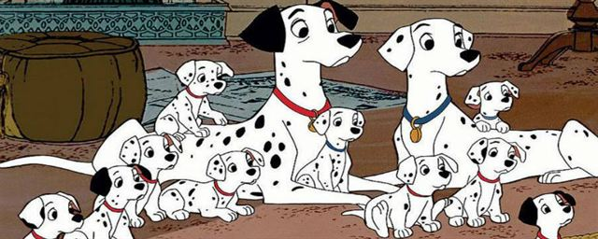

101?

Slide 3
101
“101 is a topic for beginners in any area. It has all the basic principles and concepts that is expected in a particular field”

Slide 4
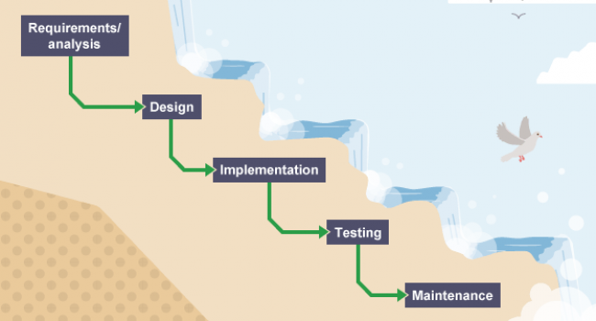
SOFTWARE DEVELOPMENT LIFE CYCLE

Slide 5
Agile manifesto
“Our highest priority is to satisfy the customer
through early and continuous delivery
of valuable software”

Slide 6
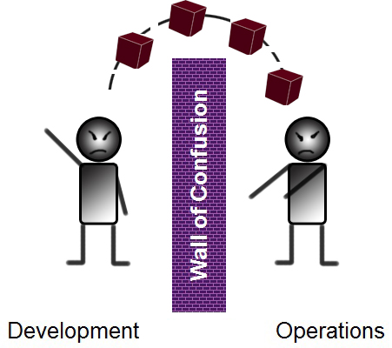
Continuous delivery – Dev vs ops

Slide 7
Dev and ops = devops
Integration and empathy between areas
Simplification, automation and rationalization of processes
Shift left

Slide 8
And sec?
DevSecOps is nothing else than bringing the security team into the empathy circle and shifting security tests left

Slide 9
SHIFT LEFT
“The earlier you test, the better, and you should test consistently and continuously”

Slide 10
Why shift left?
“Defects found ‘in the field’ cost 50-200 times as much to correct as those corrected earlier”
Boehm, Barry W. and Philip N. Papaccio. 'Understanding and Controlling Software Costs,' IEEE Transactions on Software Engineering, v. 14, no. 10, October 1988, pp. 1462-1477

Slide 11
HOW TO SHIFT SECURITY LEFT?

Slide 12
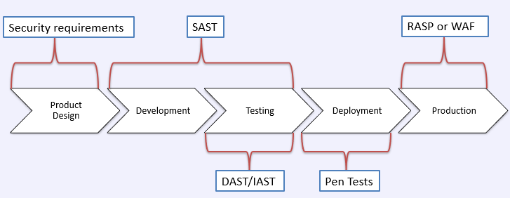
Shifting security left

Slide 13
Security requirements
Do you know what are the threats to your software?
No?
Then you need to start Threat Modeling!

Slide 14
Threat modeling
What are we building?
What could go wrong?
What are we going to do about it?
Did we do a good enough job?

Slide 15
1. What are we building?
A description / design / model of what you’re worried about

Slide 16
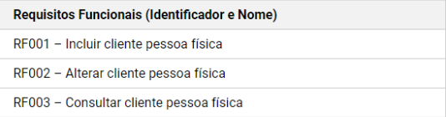
1. What are we building?

Slide 17
2. WHAT could GO WRONG?
A list of potential threats to the system

Slide 18
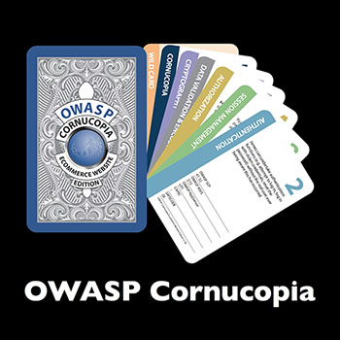
2. What could go wrong?

Slide 19
3. What are we going to do about it?
A list of actions to be taken for each threat

Slide 20
3. What are we going to do about it?
“The user in any way should be able to see contracts which are not of his responsability. The access privilege should guarantee that the user only access functions, screens and properties which he is authorized to access. Reference Cornucopia Card: Authorization 7”

Slide 21
4. Did we do a good ENOUGH job?
A way of validating the model and threats, and verification of success of actions taken

Slide 22
4. Did we do a good ENOUGH job?
Unit tests

Slide 23
SAST/DAST
Do you trust in the code you write?

Slide 24
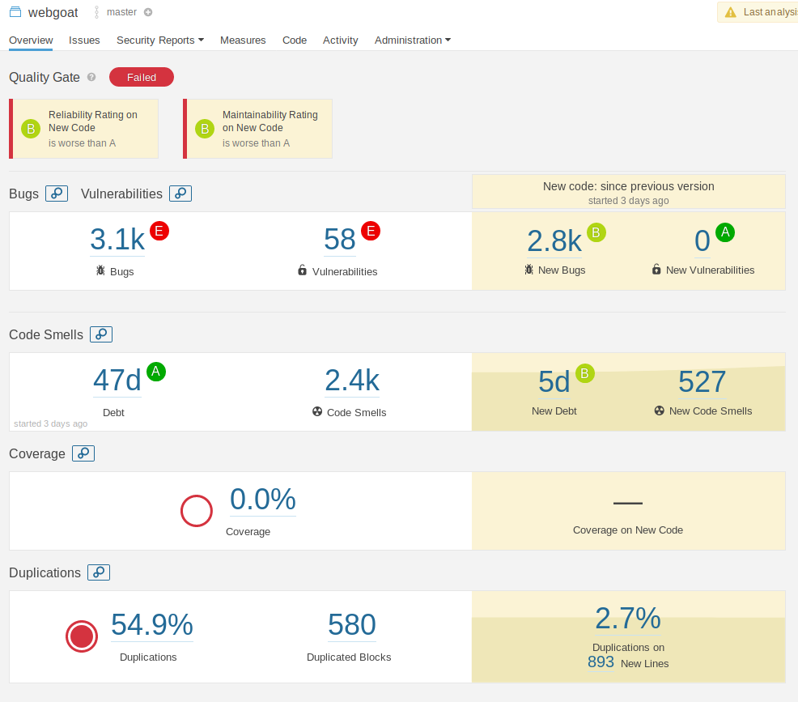
SAST

Slide 25
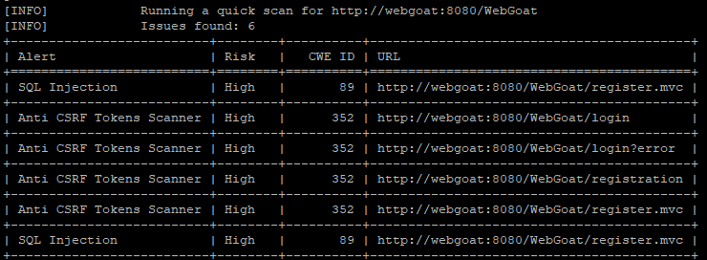
DAST

Slide 26
OPEN SOURCE/Dependency check
“80% of the code in today’s applications come from libraries and frameworks”
https://cdn2.hubspot.net/hub/203759/file-1100864196-pdf/docs/Contrast_-_Insecure_Libraries_2014.pdf

Slide 27
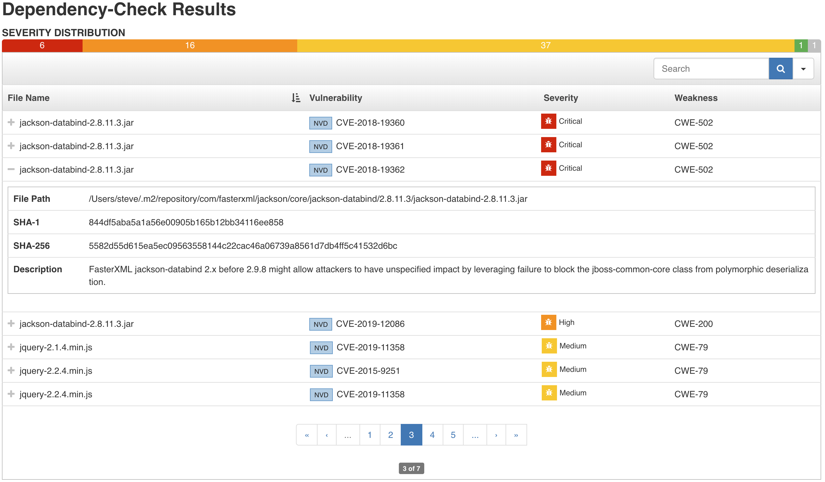
OPEN SOURCE/Dependency check

Slide 28
MISCONFIGURATION
admin/admin

Slide 29
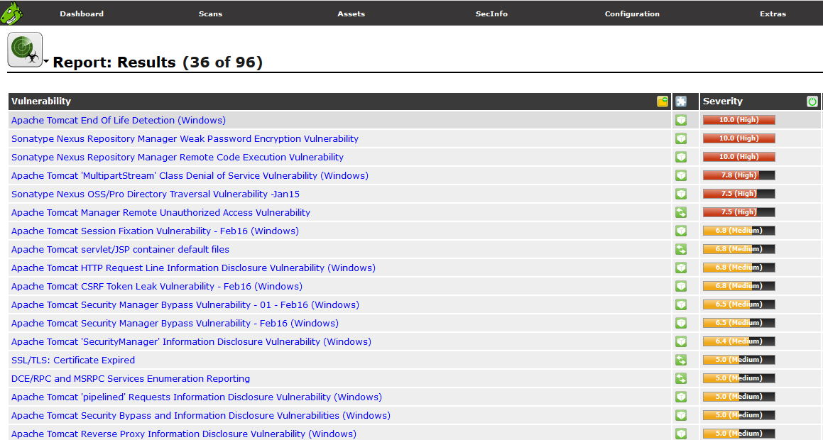
MISCONFIGUration

Slide 30
measurement
How can we know if the security left shift is really effective?
KPIs are the answer

Slide 31
measurement
Number of builds broken due to security errors
% of security bugs found compared to “normal” bugs
% of security unit tests coverage

Slide 32
WHEN WILL YOU START THE SHIFT LEFT ON SECURITY?

Slide 33

marcelo.yuri@db1.com.br
db1group.com/CARREIRA

